Slide 1
How to measure and reward biodiversity on dairy farms?

Slide 2
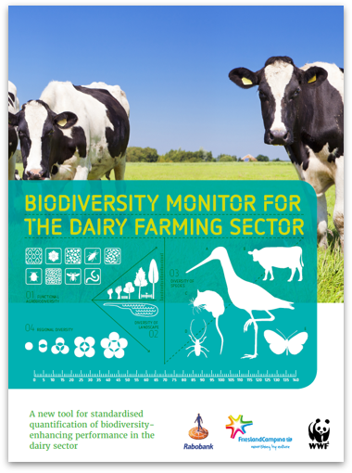
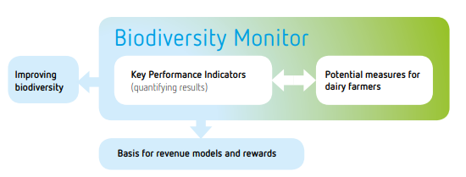
Integral assignment - > joint approach
Implementation of different goals Biodiversity, nitrogen, water quality, climate
Biodiversity Monitor as tool Steering for goals, insight into impact
Incentive tool for farmers Private and public

Slide 3
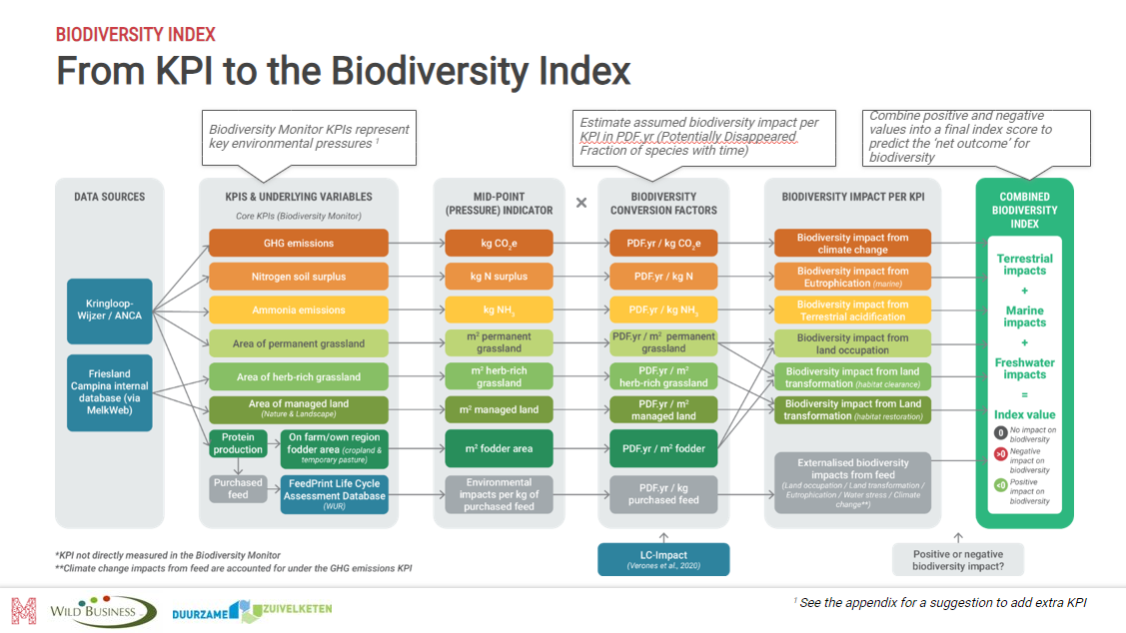
What did we do?
2014 Start
2017 Study witch KPI for with goal
2021 Scaling up
2022 study KPI > BI and review 2023
2021-2025 Pilots in the regions
2024 Improve registration Nature- en landscape
2025 Study extra KPI’s water, phosporus soil plus and pesticides

Slide 4
Biodiversity Monitor
Integral management by the farmer on (company-specific) goals
KPI systems can make performance transparent, clear and impact measurable
Preventing trade offs.
Net positive impact
Basis for revenue models and rewards
Increasing the positive impact
1
Greenhouse gas emissions
4
Protein produced by in farmer’s own region
5
Permanent grassland
6
Nature & Landscape
2
Ammonia emissions (NH3)
7
Herb-rich grassland
3
Nitrogen soil surplus
Rapport:
Prototype biodiversiteitsmonitor melkveehouderij, Uitgave Rabobank 2017 (gezamenlijke productie v/d partners)
Reducing the negative impact

Slide 5
How does it land on my farm?
rearing young cattle
Age by leaving the farm
Rearing young cattle
- 0,2% interest
Greenhouse gas emissions
Nitrogen soil surplus
Ammonia emissions (NH3)
Protein produced in farmer’s own region
Permanent grassland
Nature & Landscape

Slide 6
More information:
Wilco Brouwer de Koning, wbrouwerdekoning@lto.nl
What is the biodiversity monitor? https://biodiversiteitsmonitor.nl/docs/Biodiversiteitsmonitor_engels.pdf
Report: A Net Positive Impact on Nature for the Dutch Dairy
https://www.duurzamezuivelketen.nl/resources/uploads/2023/07/ZuivelNL-Duurzame-Zuivelketen-Onderzoek-integrale-indicator-biodiversiteit-Methode-ENG.pdf

