Slide 1



HOW TO MEASURE AND REWARD
BIODIVERSITY IN DAIRY
A Comprehensive Framework for the Dairy Sector
Wilco Brouwer de Koning | Nuffield Scholar 2025-2026

Slide 2
ABOUT WILCO BROUWER DE KONING
THE FARMER
THE FARM LEADER
Third-generation dairy farmer at Boerderij Ter Coulster in Heiloo, Netherlands
Started in 1954 by my Grandpa Wim
Farming together with my brother, family, labor
2 Farm locations, in the heart of Heiloo
180 dairy cows on total 125 hectares
42 hectares of nature land for biodiversity
Family farm with three generations
Farm located in densely populated area with 25,000 neighbors
Board member, LTO Netherlands (Dutch Farmers Organization)
International Dairy farmer representative, Science & Programme Coordination Committee, International Dairy Federation (IDF)
Member Council Agrifirm
Nuffield Scholar 2025-2026

Slide 3
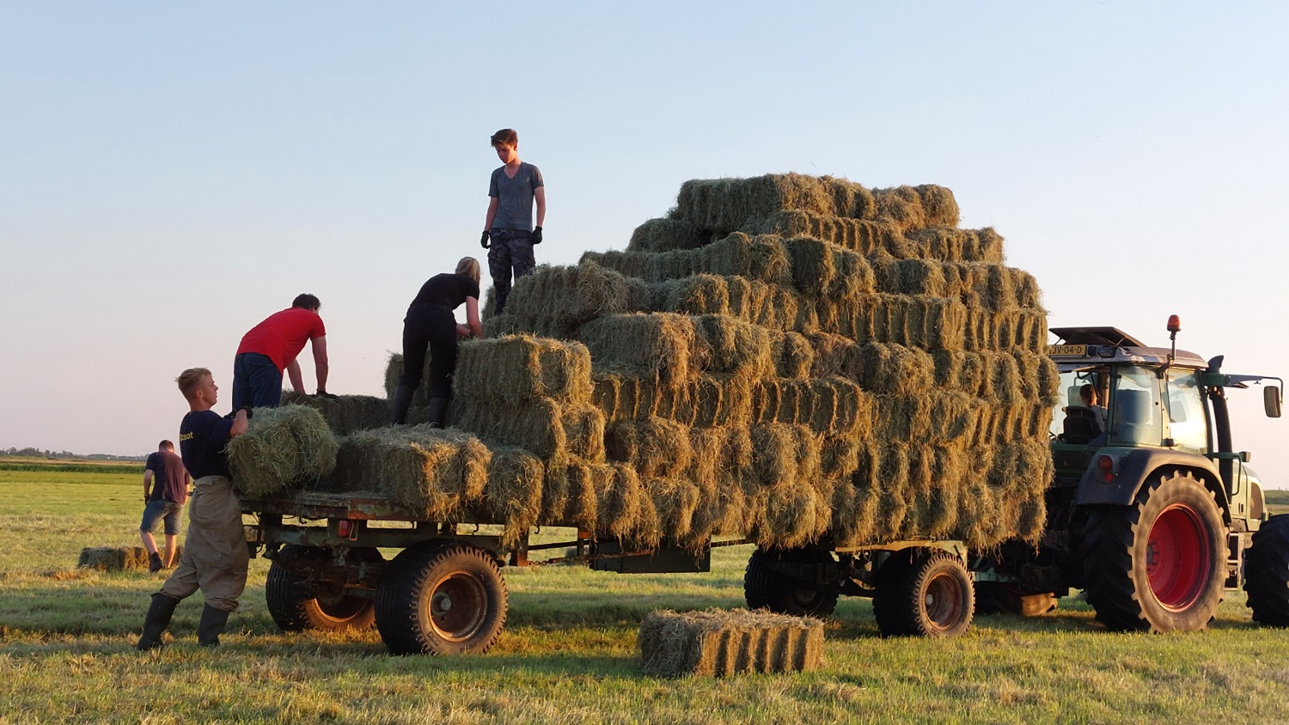
BOERDERIJ TER COULSTER
A third-generation Dairy farm

Slide 4
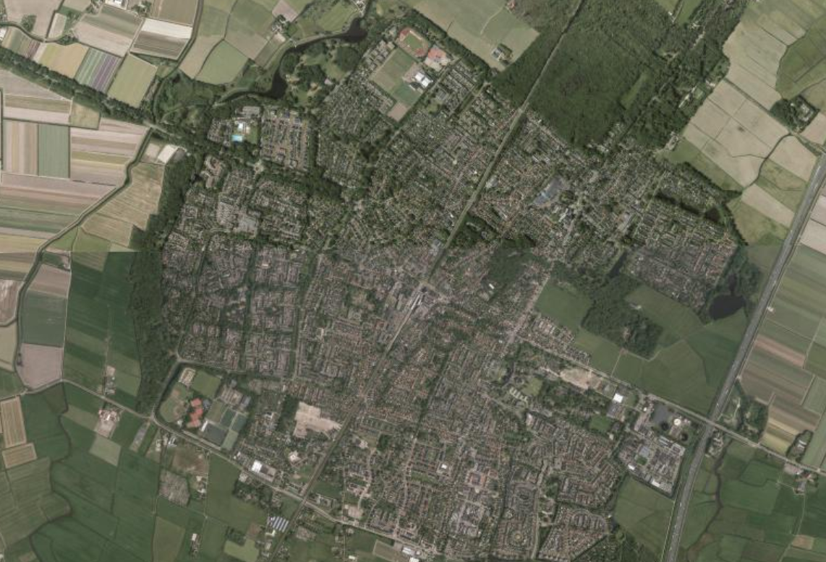
BOERDERIJ TER COULSTER
27.000 direct neighbors

Slide 5
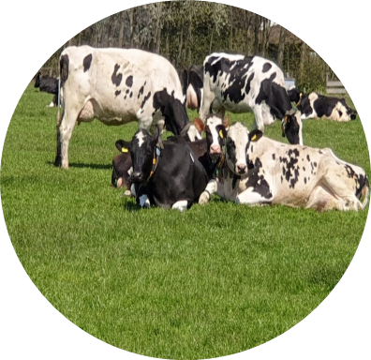
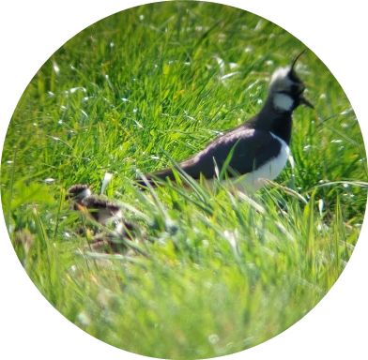
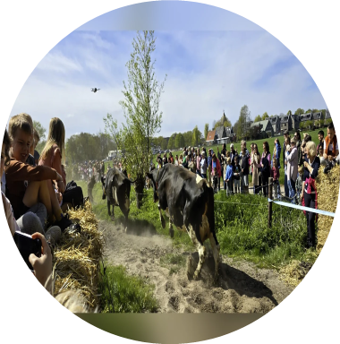
BOERDERIJ TER COULSTER
Three core pillars guide our farming approach
GRAZING
Primarily grass-fed cows grazing outdoors from April to November whenever possible
1
COMBINATION WITH NATURE
42 hectares of nature land and 23 ha of agricultural nature land.
2
CONNECTION WITH COMMUNITY
Open engagement with events, social media, selling farm products.
3

Slide 6
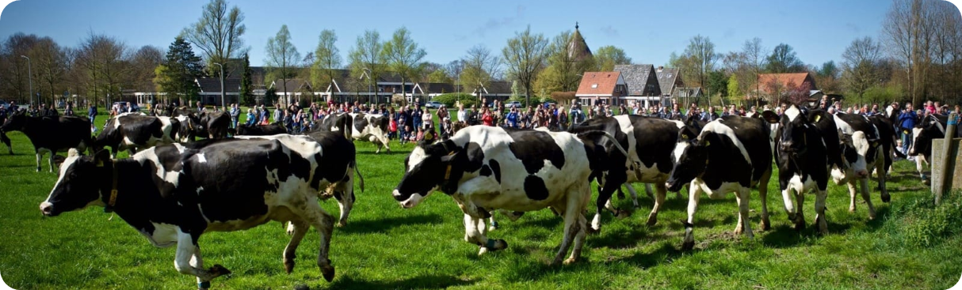
GRAZING
From April to November
Dairy cows around the farm, young stock on the field further away
Nature land with dry cows and older young stock
Grass, clovers and herbs

Slide 7
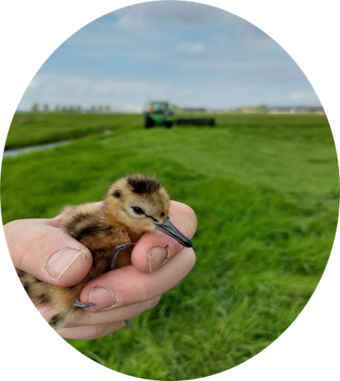
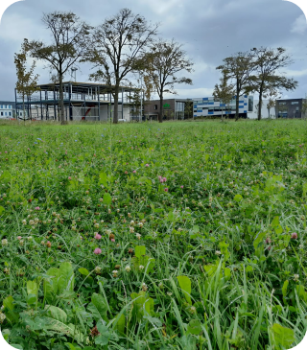
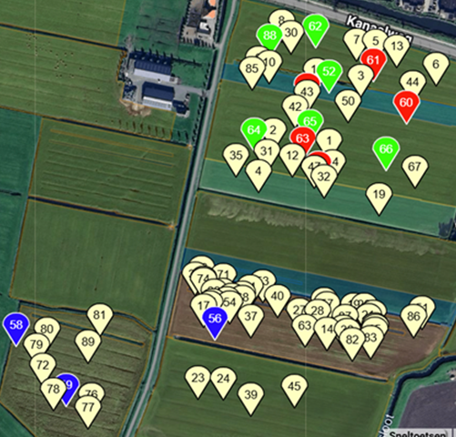
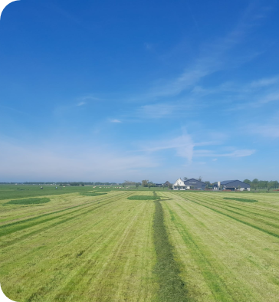
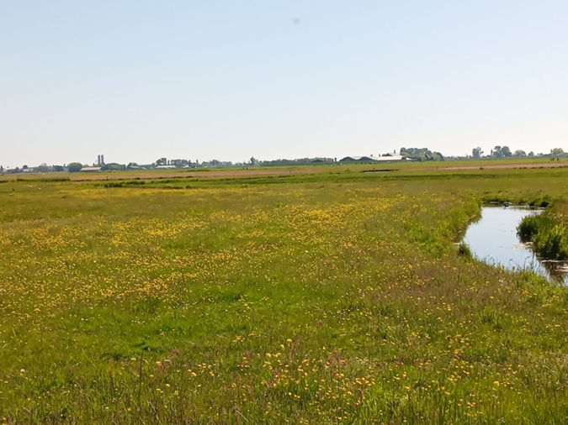
TOGETHER WITH NATURE
Production land with herb rich grassland
GPS registration of meadow birds on production land
Adapting work on meadow birds
Nature land for biodiversity and meadow birds

Slide 8

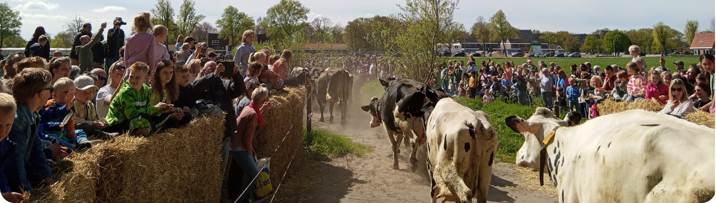
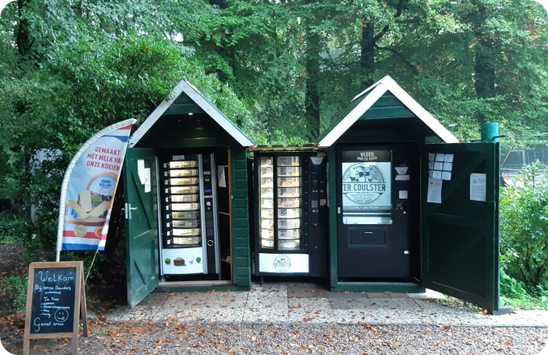
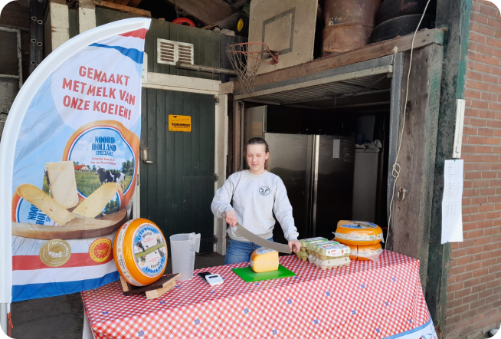
CONNECTION WITH COMMUNITY
Social media
Farm events, Open farm day and “cow dance”
Direct selling (vending machines and shop)

Slide 9

NUFFIELD SCHOLARSHIP 2025-2026
RESEARCH QUESTION
“How to measure and reward biodiversity in dairy”
OBJECTIVES
Learn from global best practices in biodiversity measurement
Understand different reward mechanisms across countries
Identify scalable solutions for Dutch, European and Global dairy farming
Tell the story about sustainable Dairy Farming

Slide 10
GLOBAL RESEARCH JOURNEY
Countries visited during Nuffield Scholarship
1. New Zealand
Pasture-based systems & environmental frameworks
2. Australia
Extensive grazing & biodiversity integration
3. United States
Technology & intensive dairy systems
4. Brazil
Tropical biodiversity & sustainable intensification
5. Chile
South American perspectives
6. Japan
Quality focus & community integration
7. Denmark
Nordic approaches to nature-inclusive farming
8. Italy
FAO, WFO & company engagement
9. Canada/US (planned)
North American dairy & biodiversity approaches
10. Italy
FAO One Health Congress
11. Armenia
CBD COP17
12. New Zealand
IDF World Dairy Congress

Slide 11
KEY FINDINGS FROM GLOBAL RESEARCH
Everything starts with Data
A data system, trusted by farmers, automatically connect with different systems, certificated and transparent.
Biodiversity is the Competitive Advantage
For pasture-based dairy systems, biodiversity offers a unique selling point that intensive systems cannot match on climate metrics alone
Measurement Drives Action
Countries with standardized biodiversity monitoring tools see faster farmer adoption and clearer progress toward environmental goals
Multiple Reward Pathways
Successful programs combine supply chain premiums, government payments, and market access benefits
Community Connection Matters
Farmers who engage with their communities about biodiversity gain social license and long-term sustainability

Slide 12
FOUR PILLARS OF BIODIVERSITY
1. FUNCTIONAL AGROBIODIVERSITY
Fertile soil, clean water, healthy nutrient cycles. Closing loops on farm level.
2. DIVERSITY OF LANDSCAPE
Hedges, trees, ditches, field margins create habitat and ecosystem services.
3. DIVERSITY OF SPECIES
Protecting and strengthening specific flora and fauna. In the soil, on land, water and air.
4. REGIONAL BIODIVERSITY
Connecting areas across farm boundaries through regional management approaches.
These pillars provide an integrated framework for assessing biodiversity on dairy farms

Slide 13
HOW TO MAKE A POSITIVE IMPACT
MITIGATION HIERARCHY
AVOID
Prevent impacts where possible
REDUCE
Minimize unavoidable impacts
COMBINE
Combine farm practices with nature.
RESTORE
Compensate for net gain
GOAL: Achieve a marginal net gain in biodiversity on a global level

Slide 14
REWARD MECHANISMS
Creating new revenue models in the supply chain
SUPPLY CHAIN PARTNERS
GOVERNMENT & POLICY
SOCIETY
Premium milk prices
Performance bonuses
Long-term contracts
Technical support
Lower interest
Agri-environment payments
Tax incentives
Subsidies for nature management
Regulatory compliance credits
License to produce
Connection
Direct payment

Slide 15
BENEFITS OF REWARDING BIODIVERSITY
FOR FARMERS
FOR SUPPLY CHAIN
FOR SOCIETY
Clear action perspective for improvement
Financial rewards for biodiversity efforts
Reduced environmental compliance risks
Enhanced farm resilience and soil health
Quantifiable sustainability metrics
Risk mitigation in sourcing
Brand value and market differentiation
Alignment with ESG commitments
Restoration of agricultural biodiversity
Protection of meadow birds and species
Improved water and air quality
Preservation of cultural landscapes

Slide 16
FUTURE WAYS to measure the positive impact on BIODIVERSITY
CHIRRUP – BIOACOUSTICS
AI-powered listening devices capture birdsong to identify species, turning bird activity into a real-time indicator of farmland biodiversity.
EDNA – ENVIRONMENTAL DNA
Traces of DNA in soil and water reveal which species are present on the farm, without ever having to see or capture them.
SENSIBEE – POLLINATOR SENSORS
Non-lethal sensor devices track insect activity around the clock, using AI to identify species and measure pollinator abundance and diversity.
SATELLITE – REMOTE SENSING
Satellite imagery tracks vegetation health, land cover and habitat structure at scale, enabling farm-wide monitoring over time.
Combined with the farm data monitoring, these tools point toward faster, cheaper and more objective on-farm biodiversity measurement

Slide 17
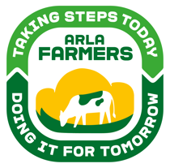

ARLA FARMAHEAD™
A Data-Driven Approach to Sustainable Dairy
Case Study: Arla Foods Cooperative

Slide 18
FARMAHEAD™ TECHNOLOGY
Three integrated tools for measuring and rewarding sustainability
ARLA: 7,600 farmers across 7 European countries • €500M annually for sustainability
1
FarmAhead™ Check
One of the world's largest validated datasets covering 99% of Arla's milk pool. Over 200 data points per farm verified by third-party advisors.
2
FarmAhead™ Incentive
Point-based reward system paying farmers up to 4 eurocents per kg milk for sustainability activities. Historical change to milk pricing model.
3
FarmAhead™ Customer Partnerships
Customers invest in on-farm sustainability and access data for their ESG reporting and scope 3 emission reduction goals.

Slide 19
CLIMATE TARGETS & THE 'BIG 5'
SCIENCE-BASED TARGETS
ACHIEVEMENTS
30.3% reduction in CO₂e per kg milk by 2030 (from 2020 baseline)
63% reduction in production & logistics by 2030
Carbon Net Zero by 2050
1 million tonnes CO₂e reduced in 2 years
8,500+ farms with verified climate data
Customers: Aldi, Asda, Morrisons, Starbucks
THE 'BIG 5' FOCUS AREAS
1. Feed efficiency - optimizing cow nutrition
2. Manure management - biogas conversion
3. Renewable energy - solar, wind on farms
4. Herd genetics - breeding for efficiency
5. Fertilizer optimization - precision application

Slide 20
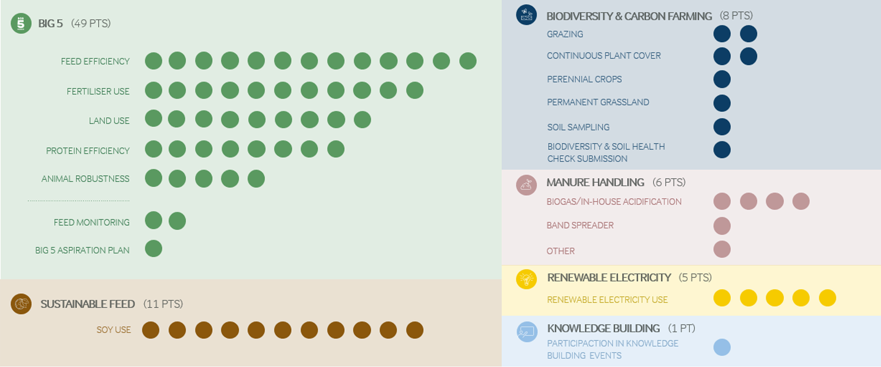
FARMAHEAD™ INCENTIVE MODEL
Point-based system rewarding sustainability actions
HOW IT WORKS
Farmers collect points for sustainability activities
Maximum 80 points currently available
Each point = 0.03 eurocent per kg milk
+1 eurocent for annual Climate Check participation
Quarterly updates with verified documentation
REWARD CRITERIA
Activities with biggest impact = most points
Based on feasibility and cost-efficiency
Covers past achievements + future actions
Transparent, verified third-party data
Integrated into monthly milk payment

Slide 21

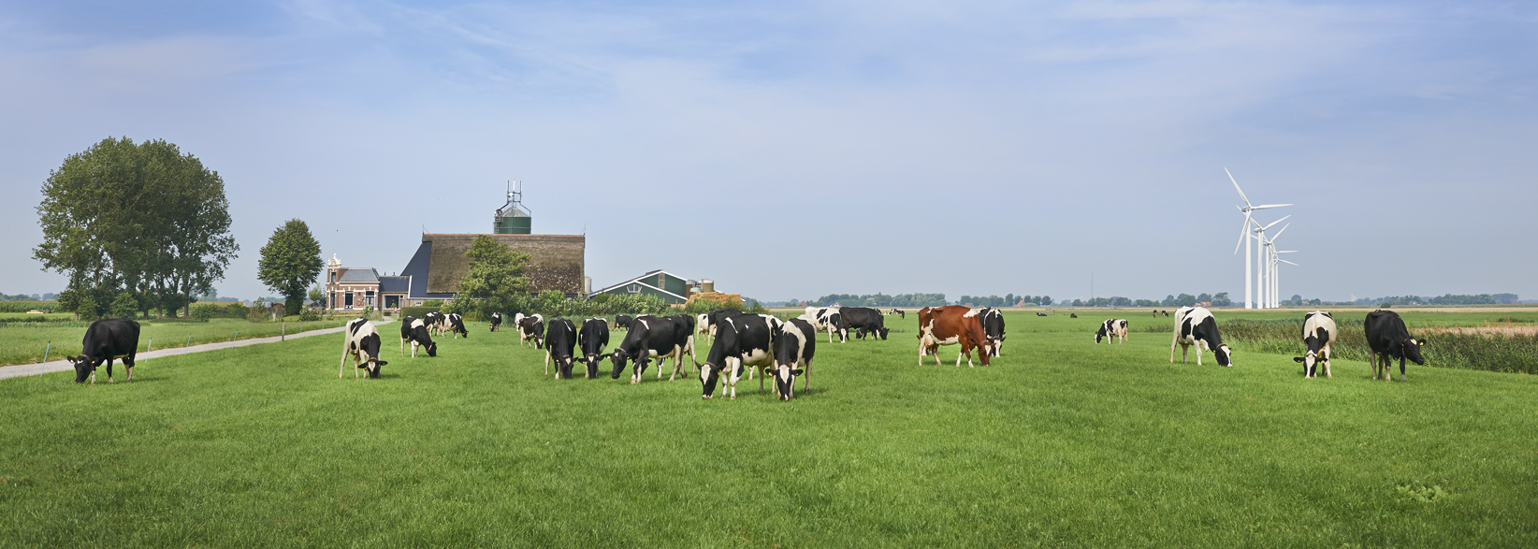


Reducing environmental impact in the Dutch dairy sector with ANCA-tool
(Annual Nutrient Cycling Assessment; KringloopWijzer)
In use since 2013

Slide 22



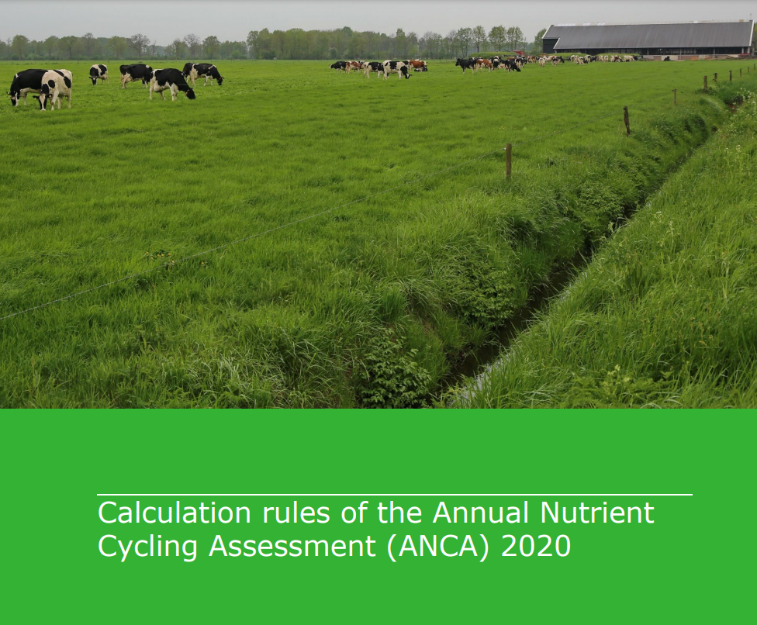


ANCA is a joint effort of the dairy sector and partners
Owner Central Database
Calculation rules ANCA by WUR
Financed by the Ministry of Agriculture, Fisheries, Food Security and Nature,
and ZuivelNL
Partners

Slide 23
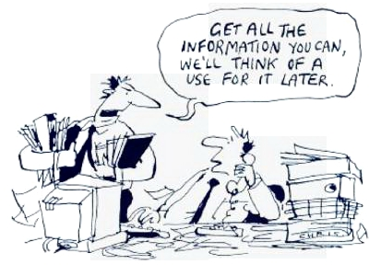

Input for ANCA
  Animals (type, number)
  Milk yield
  Grazing hours/yr*
  Farmland, land use (ha)
  Feed stocks* and imports* (grass silage, maize silage, concentrates, other)
  Contents of feed stocks (Energy/N/P/Ash/EF/cfp)
  Soil type
  Cropping plan, Legumes*
  Manure (import/export/application*/method of application)
  Artificial fertiliser (import/application*/method of application)
  Type of housing; manure separation*; manure fermentation
  Energy (gas, electricity, contract work...)

Slide 24

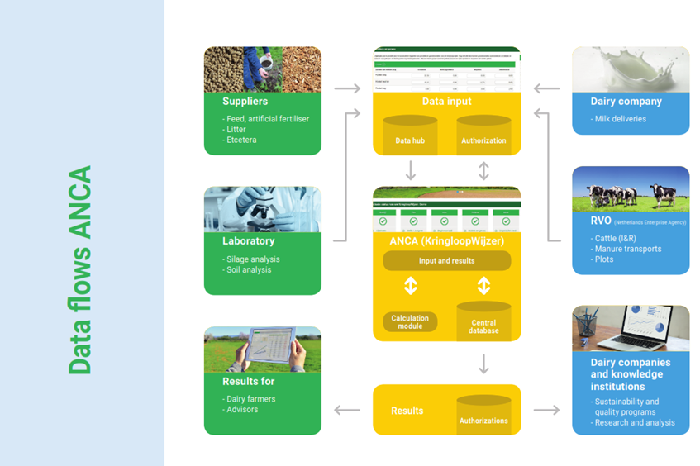
Dataprocessing with maximum automation
Feed
Com-
pany
Reporting results (anonymous/authorization)

Slide 25
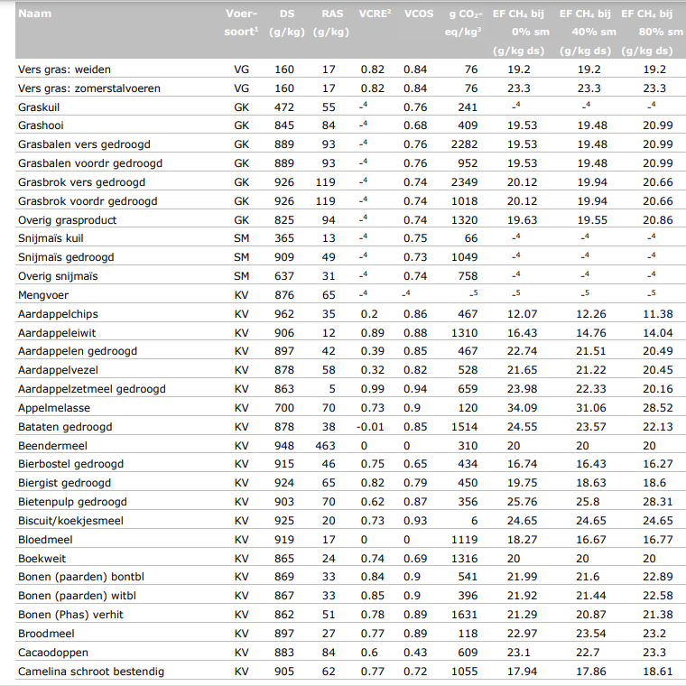

Slide 26
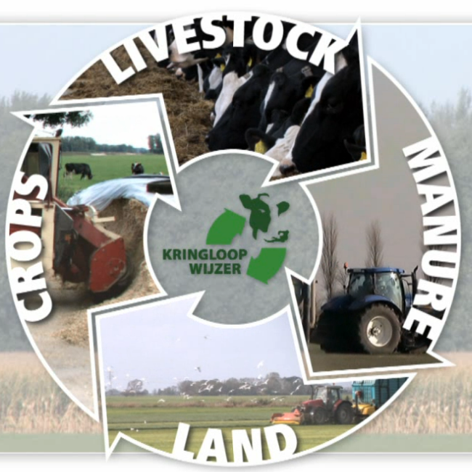
Dairy farming = nutrient cycling
  ANCA calculates environmental performance dairy farm
  Production of manure: excretion of N and P
  Surpluses of N, P on farm balance
  Surpluses of N, P on soil balance
  Ammonia emissions
  Green House Gas emissions (CH₄, N₂O, CO₂)
  C-sequestration

Slide 27
Ammonia emissions
Feed, ration
Cattle (cows, heifers, calves
N-excretion (urine + manure)
NH3
45%-50%
Barn
External manure storage
NH3
fertiliser
grazing
manure (slurry, solid)
Fertiliser
NH3
NH3
NH3
35%-45%
NH3
NH3
Grass land
Arable land

Slide 28
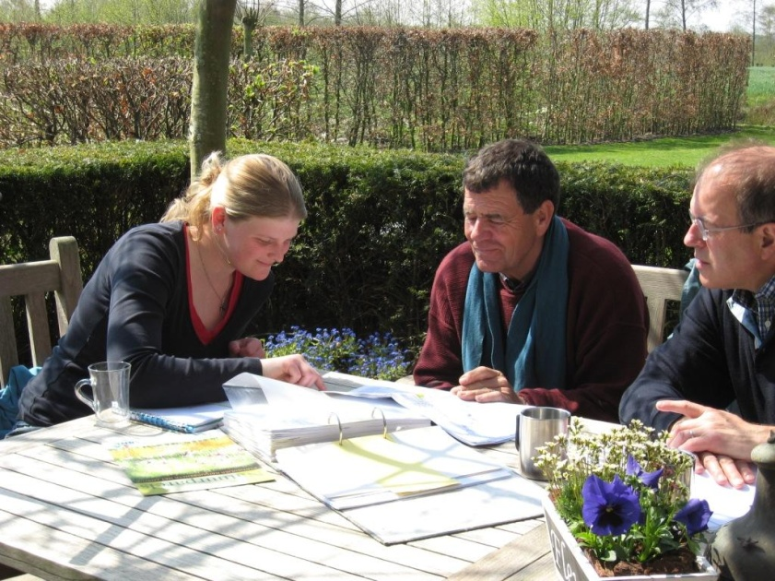
measures for reducing GHG
  fodder low on EF CH4 (appendix 4, report 1023)
  fodder low on carbon footprint; interaction with feed supplier
  High feed efficiency
  High milk yield
  Additives
  Manure digester, methane oxidation
  Less application of (artificial) fertilizer
  (permanent) grassland

Slide 29
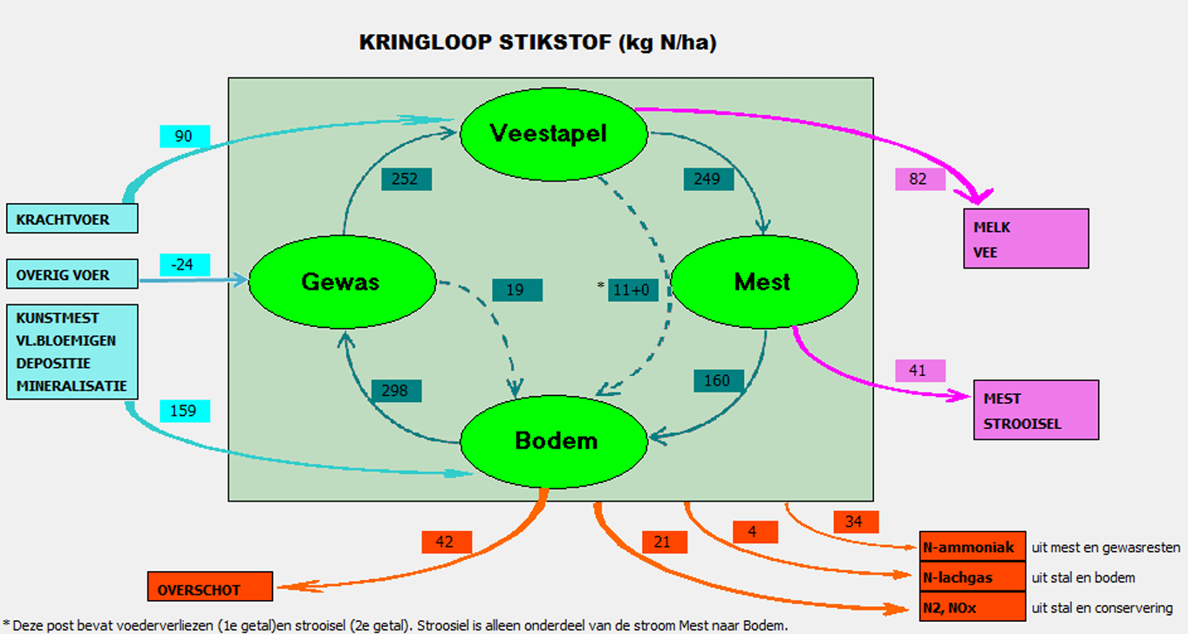

Slide 30




THE BIODIVERSITYMONITOR
A Data-Driven Approach to Sustainable Dairy
Case Study: The Biodiversity Monitor

Slide 31
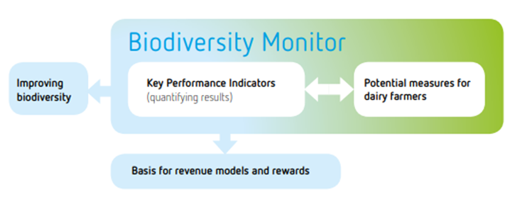
THE BIODIVERISTY MONITOR (NL)
A collaborative initiative driving change
INITIATORS: FrieslandCampina • Rabobank • WWF Netherlands
KEY OBJECTIVES
NEXT STEPS
Develop standardized measurement tool
Enable sustainable revenue for farmers
Create supply chain incentives
Restore biodiversity in agriculture
Pilot testing with dairy farmers
Refine technical methodology
Engage other supply chain partners
Establish independent governance

Slide 32
THE BIODIVERSITY MONITOR SOLUTION
A standardized tool to quantify and reward biodiversity-enhancing performance
MEASURE
MONITOR
REWARD
Key Performance Indicators
Standardized methodology
Farm-level data collection
Track progress over time
Compare farm performance
Identify improvement areas
Supply chain incentives
Financial rewards
Market recognition
Used by the government to steer on goals.

Slide 33
PRACTICAL MEASURES FOR FARMERS
ON-FARM ACTIONS
MANAGEMENT PRACTICES
Increase permanent grassland
Overseed clover in grassland
Postpone first mowing date
Create herb-rich grassland borders
Plant hedges and field margins
Install ponds and wildlife corridors
Reduce chemical fertilizer use
Implement meadow grazing
Improve nutrient cycle efficiency
Optimize protein production on own land
Reduce purchased feed imports
Participate in agri-environment schemes
Join regional nature networks
Monitor soil health and biodiversity
Adopt precision farming techniques
Engage in collective landscape planning

Slide 34
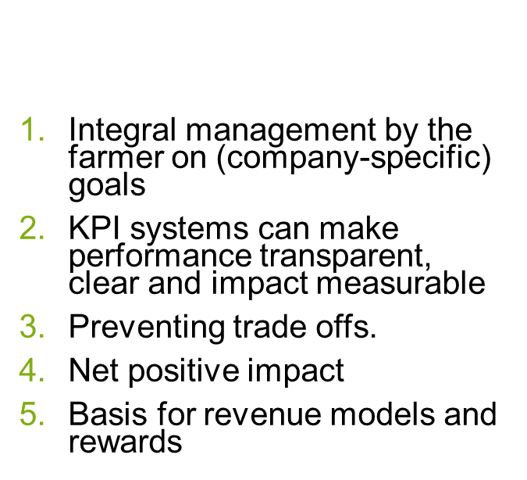
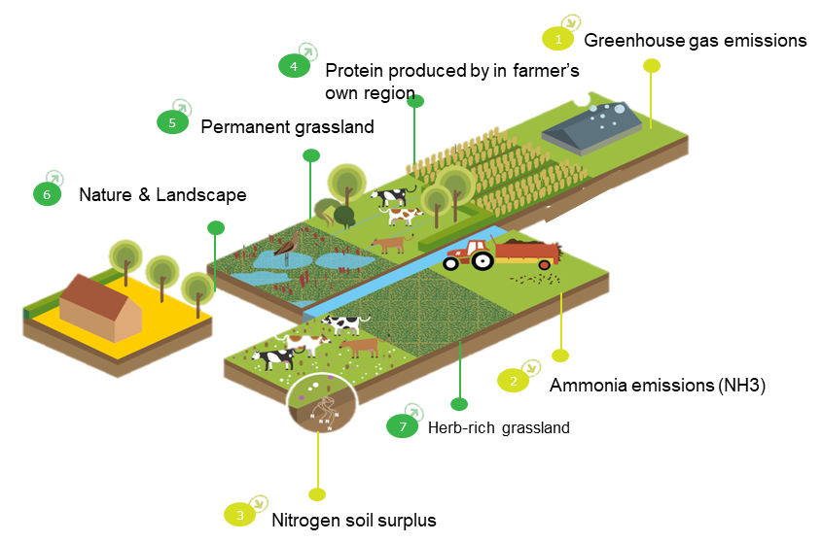
KEY PERFORMANCE INDICATORS (KPIs)
Seven integrated KPIs measure biodiversity performance:
The Biodiversity monitor

Slide 35
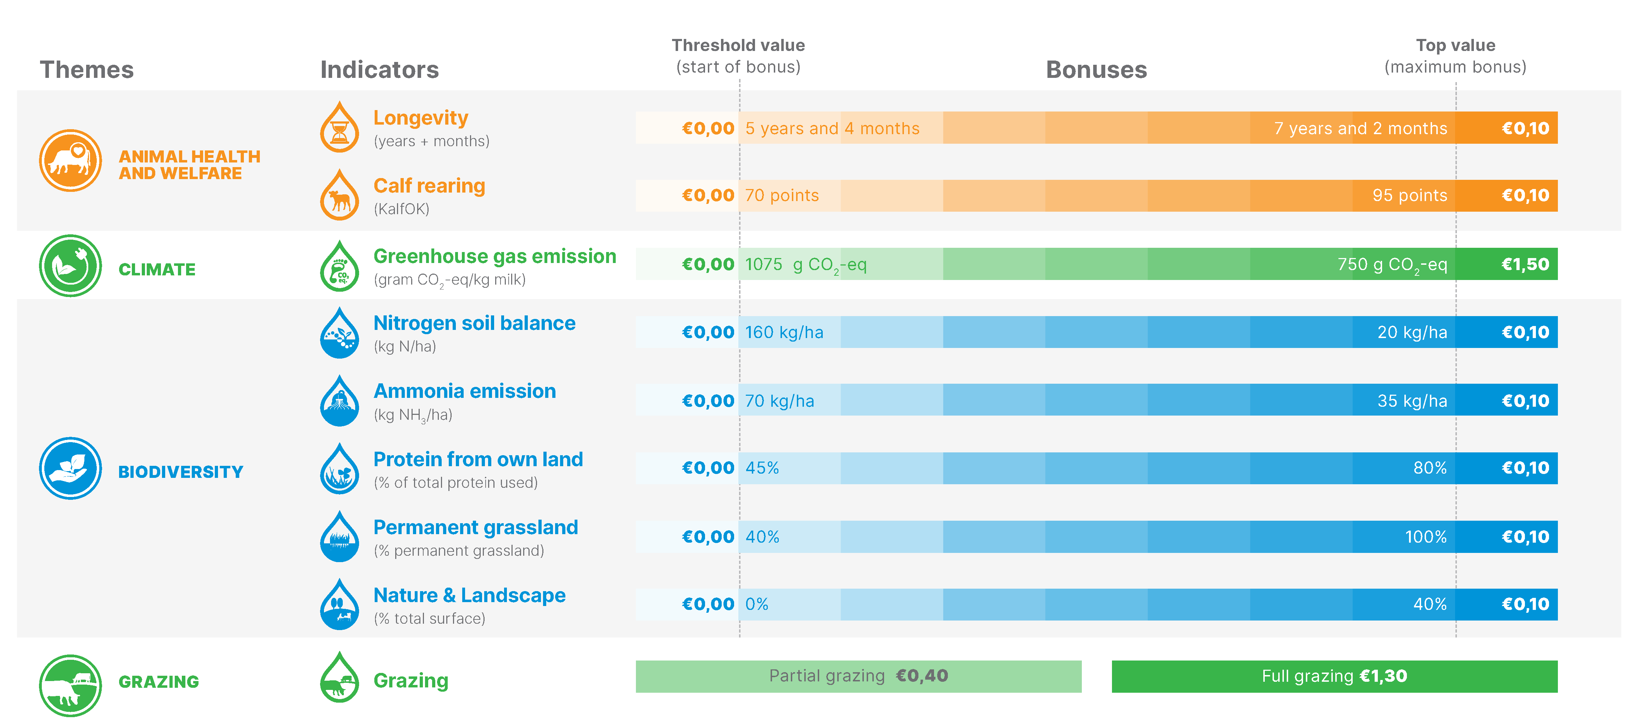

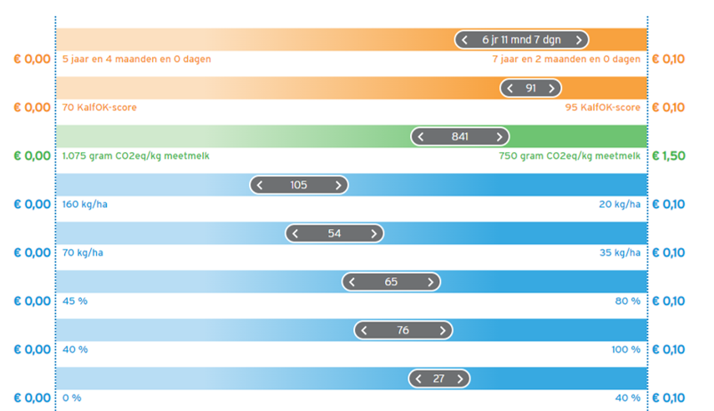




SUSTAINABILTY ON OUR FARM, 2024
Sustainable development
- 0,2% interest
Notes:
Members choose their own measures and are rewarded for their results
Integral approach, incentives on animal health and welfare, climate, biodiversity and grazing at the same time.

Slide 36
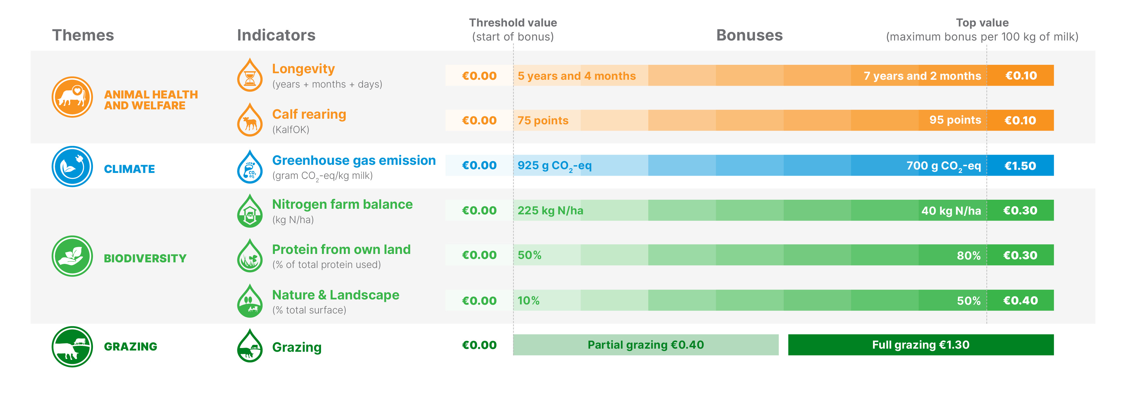
Table Sustainable development 2026, a shift forwards Biodiversity

Slide 37
(Future) dilemma’s
ON-FARM
Sector (world)wide
Trust in sharing data
1 System for different users in the sector
“Enough” money to make a change (inflation)
Knowledge
Long term
One global system, SAI platform?
Competition or working together?
How measure different farm systems?
Which data? KPI’s?
Is everyone invention the wheel again?
Goal st

Slide 38
LET'S CONNECT
Wilco Brouwer de Koning
www.biodiversityindairy.com
www.boerderijtercoulster.nl
wbdk@live.nl/info@biodiversityindairy.com
+31622554536

